Slide 1
Functions.
Scope and Callbacks.

Slide 2
Objectives
Create functions with ease
Understand all parts of a function
Familiarize with anonymous and callback functions
Discuss Scope

Slide 3
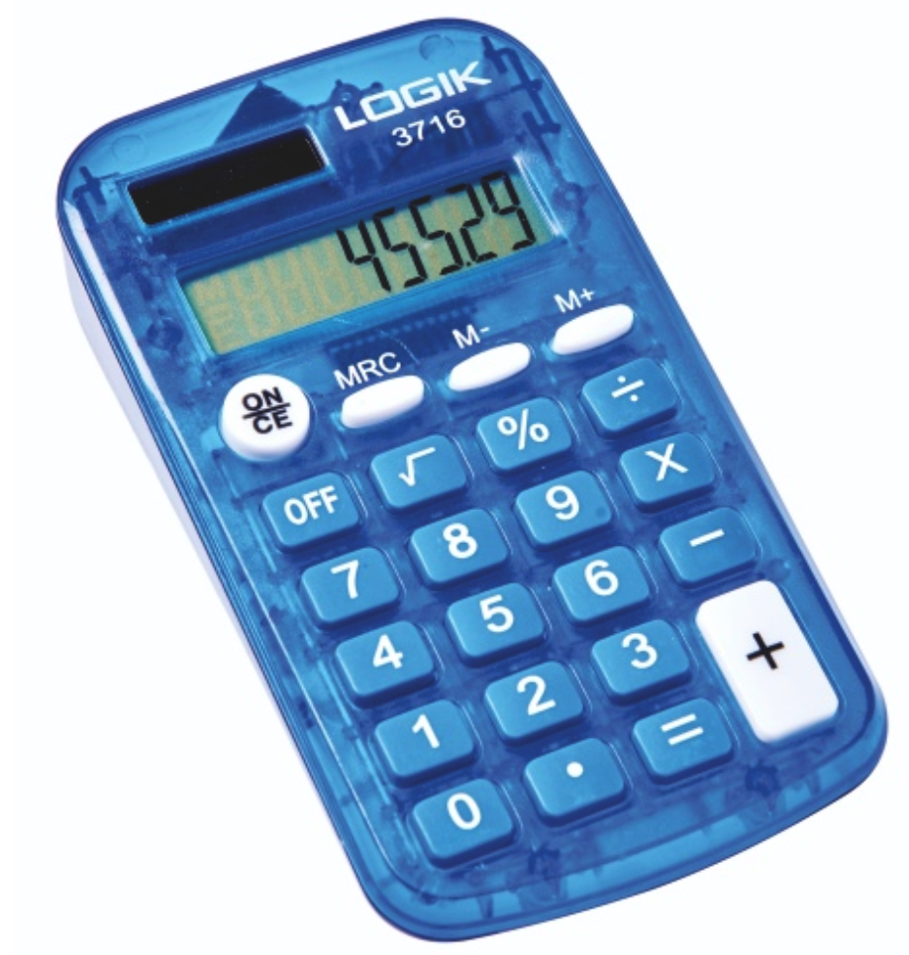

What is a function?
Reusable piece of code
Block of code to perform a task
e.g. calculate a value
DRY (Don’t Repeat Yourself) Principle

Slide 4
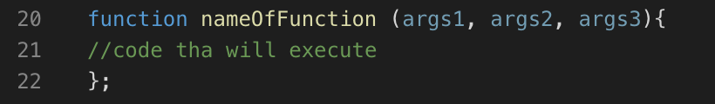
Anatomy of a Function
keyword name parameters/arguments
{ } hold the function block/ body

Slide 5
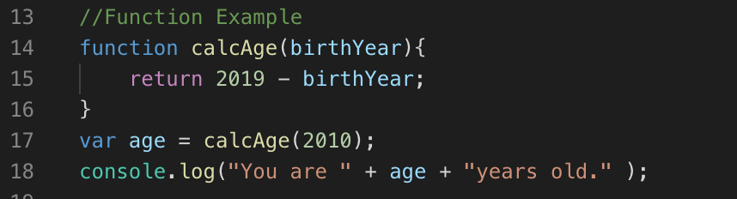
Function Example
NOTE: The function must be invoked or called to be utilized

Slide 6
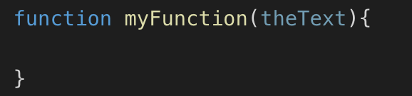
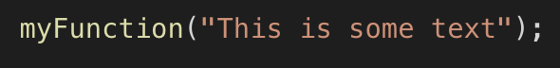
Distinctions
Parameters
Values that can be included when the function is called
Arguments
When you pass the actual value

Slide 7
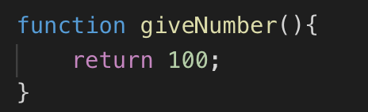
Return
Return value refers to the function’s produced value
You can set this value using a return statement
If you don’t specify a return value the function will return undefined

Slide 8
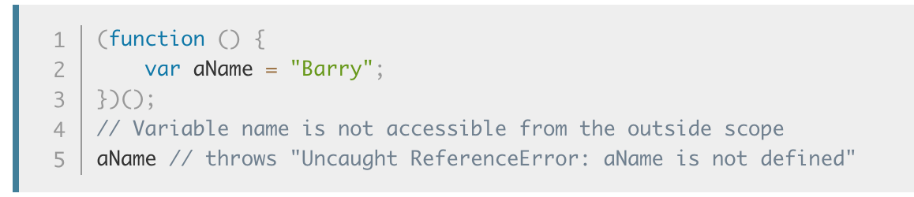
Anonymous Function Example

Slide 9
Anonymous Function
Declared as they are run
Nameless
Executed immediately when it is run, instead of having it reference a function
IIFE (Immediately Invoked Function Expression).

Slide 10
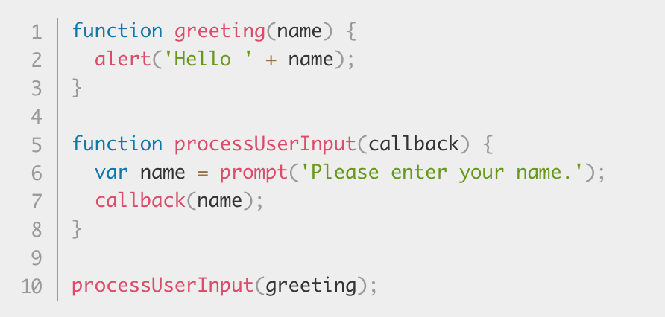
Callback Function
A callback function is a function passed into another function as an argument, which is then invoked inside the outer function to complete some kind of routine or action.

Slide 11
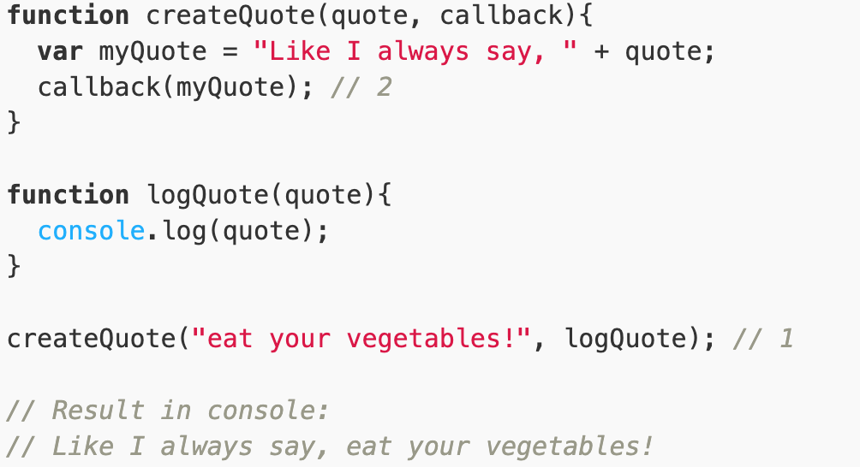
Callback Function

Slide 12


Scope
Scope allows us to determine where in our program a variable is accessible

Slide 13
Scope
Two types of scope:
Local scope
Global scope
Each function creates a new scope
This is the only way to create a new scope, unlike other programming languages...

Slide 14
Scope: Functions
Variables created inside of a function are considered local variables
They can only be used within the function
Variables created outside of a function are considered global variables
They can be used anywhere in the program

Slide 15
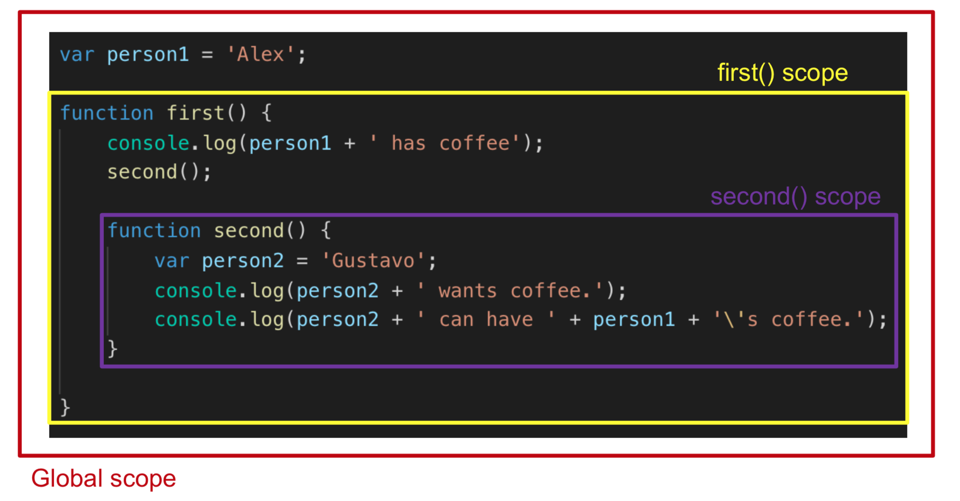
Is person1 a local or global variable? person2?

Slide 16
Lexical Scoping
When a function is written inside another function, the inner function has access to the scope of the parent function

Slide 17
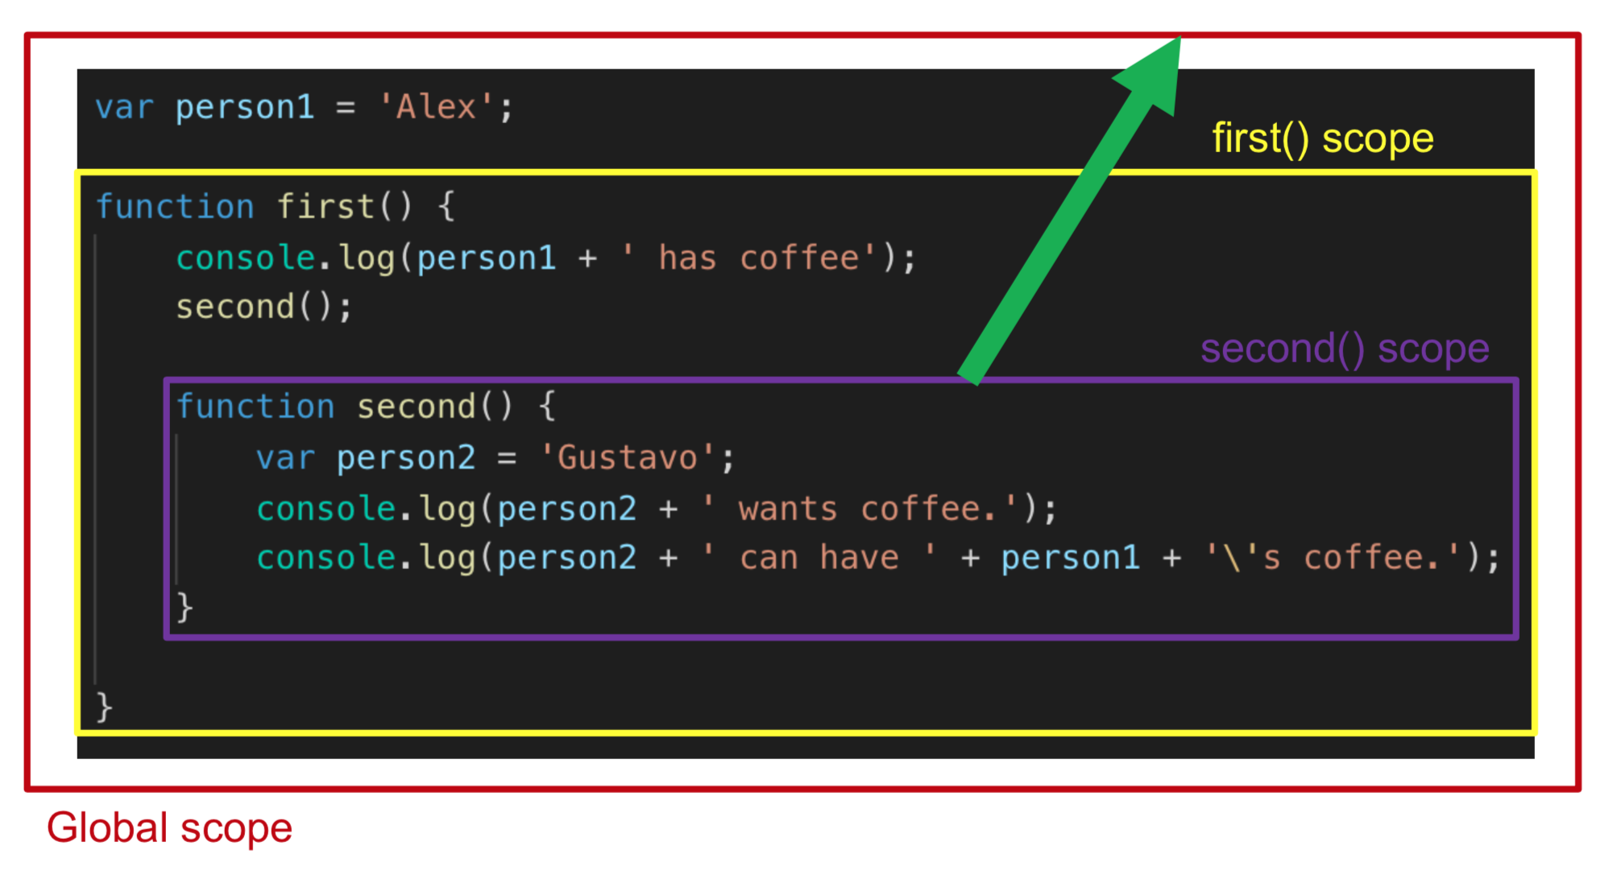

Slide 18

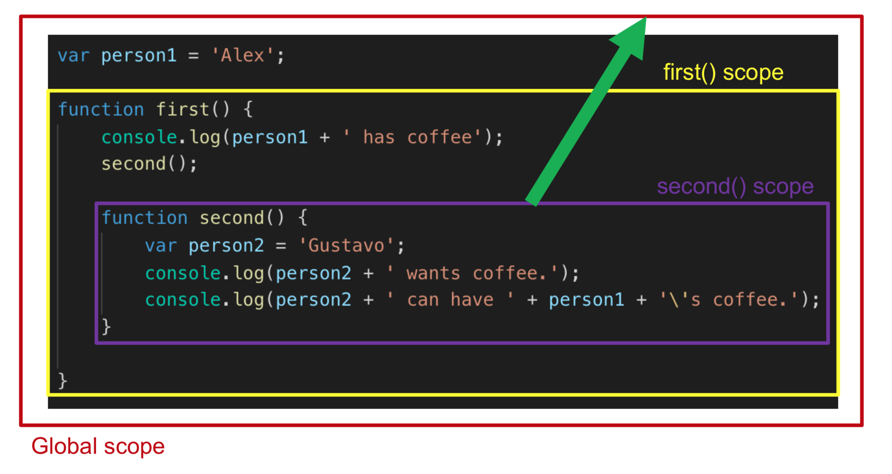
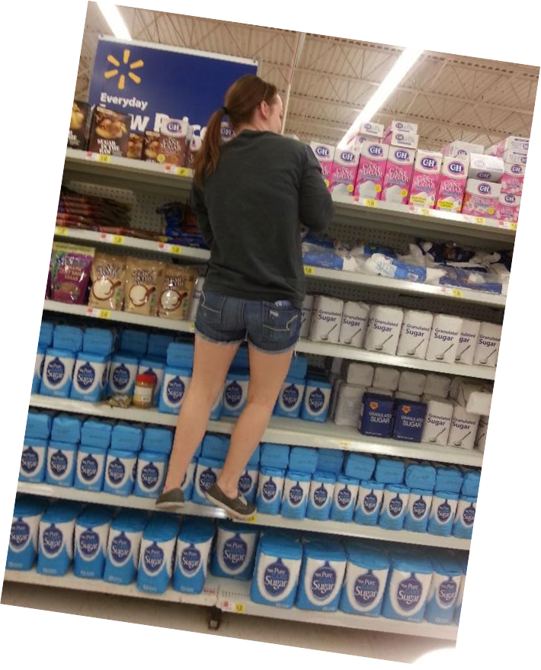


Slide 19
Scope Chain
Order in which functions are written lexically
If a variable is not found locally, we search for the variable in the parent until we either find it / don’t find it

Slide 20
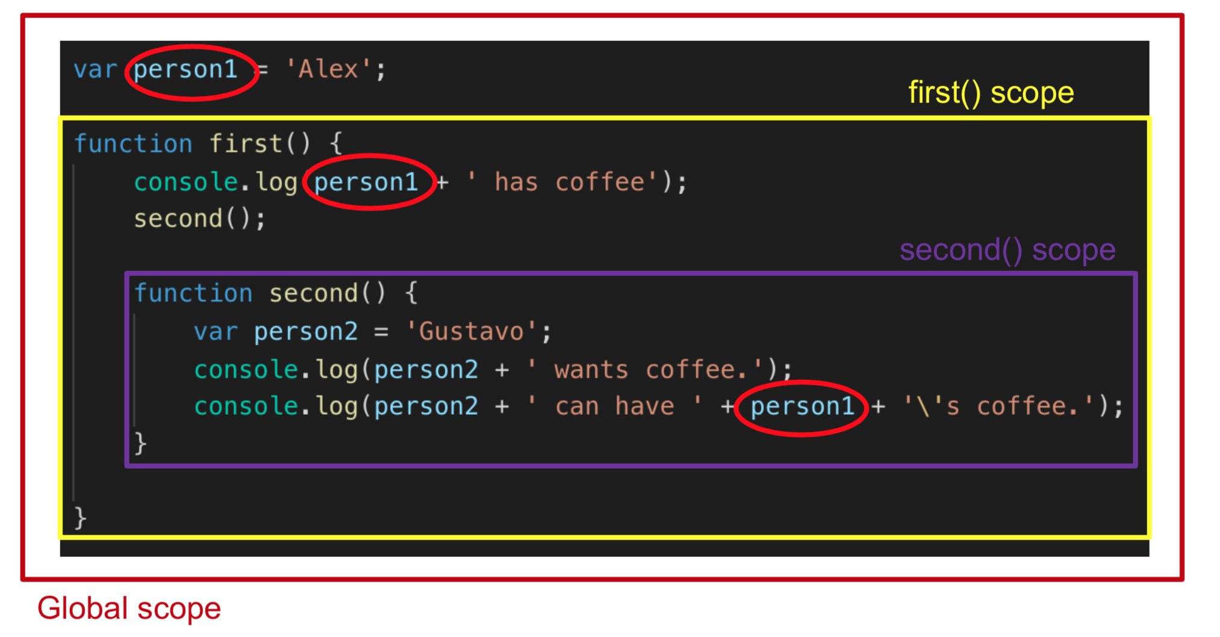

Slide 21
Resources
IIFE
https://developer.mozilla.org/en-US/docs/Glossary/IIFE
Scope
https://www.w3schools.com/js/js_scope.asp
https://css-tricks.com/javascript-scope-closures/
https://geeksforgeeks.org/understanding-variable-scopes-in-javascript/
Callbacks
https://youtu.be/xHneyv38Jro

